Slide 1
CHAPTER 4:
Scatterplots and Correlation
The Basic Practice of Statistics
6th Edition
Moore / Notz / Fligner
Lecture PowerPoint Slides
Notes:
Basic Practice of Statistics - 3rd Edition
Chapter 5

Slide 2
Chapter 4 Concepts
Explanatory and Response Variables
Displaying Relationships: Scatterplots
Interpreting Scatterplots
Adding Categorical Variables to Scatterplots
Measuring Linear Association: Correlation
Facts About Correlation

Slide 3
Chapter 4 Objectives
Define explanatory and response variables
Construct and interpret scatterplots
Add categorical variables to scatterplots
Calculate and interpret correlation
Describe facts about correlation

Slide 4
Scatterplot
The most useful graph for displaying the relationship between two quantitative variables is a scatterplot.
A scatterplot shows the relationship between two quantitative variables measured on the same individuals. The values of one variable appear on the horizontal axis, and the values of the other variable appear on the vertical axis. Each individual in the data appears as a point on the graph.
How to Make a Scatterplot
Decide which variable should go on each axis. If a distinction exists, plot the explanatory variable on the x-axis and the response variable on the y-axis.
Label and scale your axes.
Plot individual data values.

Slide 5



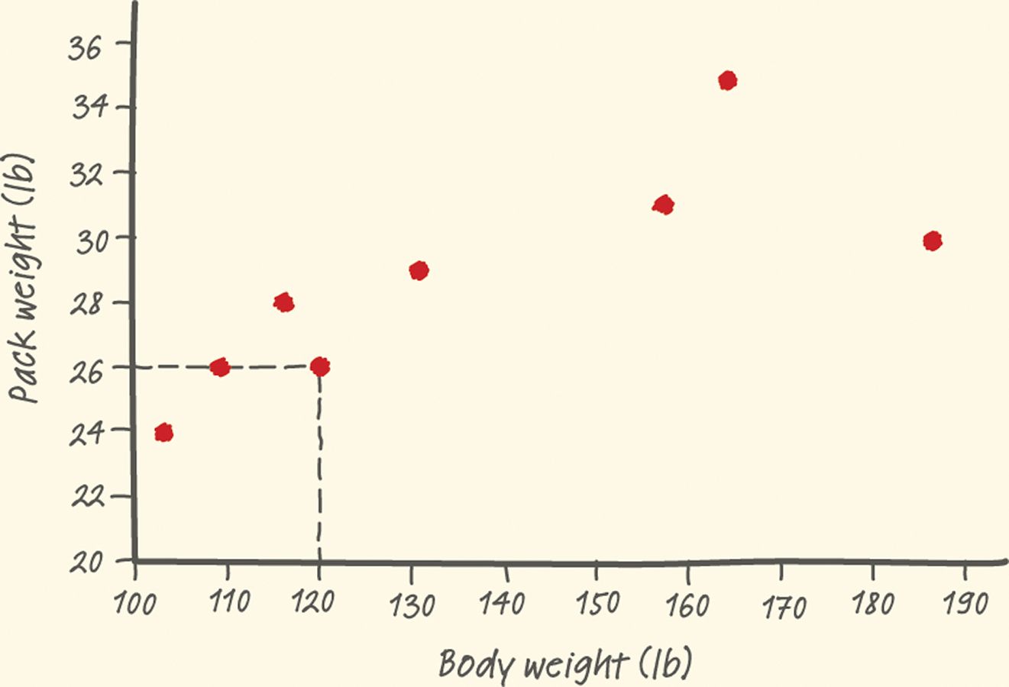
Scatterplot
  Example: Make a scatterplot of the relationship between body weight and pack weight for a group of hikers.
Body weight (lb) | 120 | 187 | 109 | 103 | 131 | 165 | 158 | 116
Backpack weight (lb) | 26 | 30 | 26 | 24 | 29 | 35 | 31 | 28

Slide 6
Interpreting Scatterplots
  To interpret a scatterplot, follow the basic strategy of data analysis from Chapters 1 and 2. Look for patterns and important departures from those patterns.
How to Examine a Scatterplot
As in any graph of data, look for the overall pattern and for striking departures from that pattern.
You can describe the overall pattern of a scatterplot by the direction, form, and strength of the relationship.
An important kind of departure is an outlier, an individual value that falls outside the overall pattern of the relationship.

Slide 7
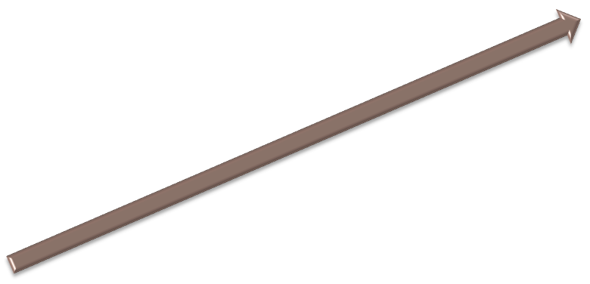
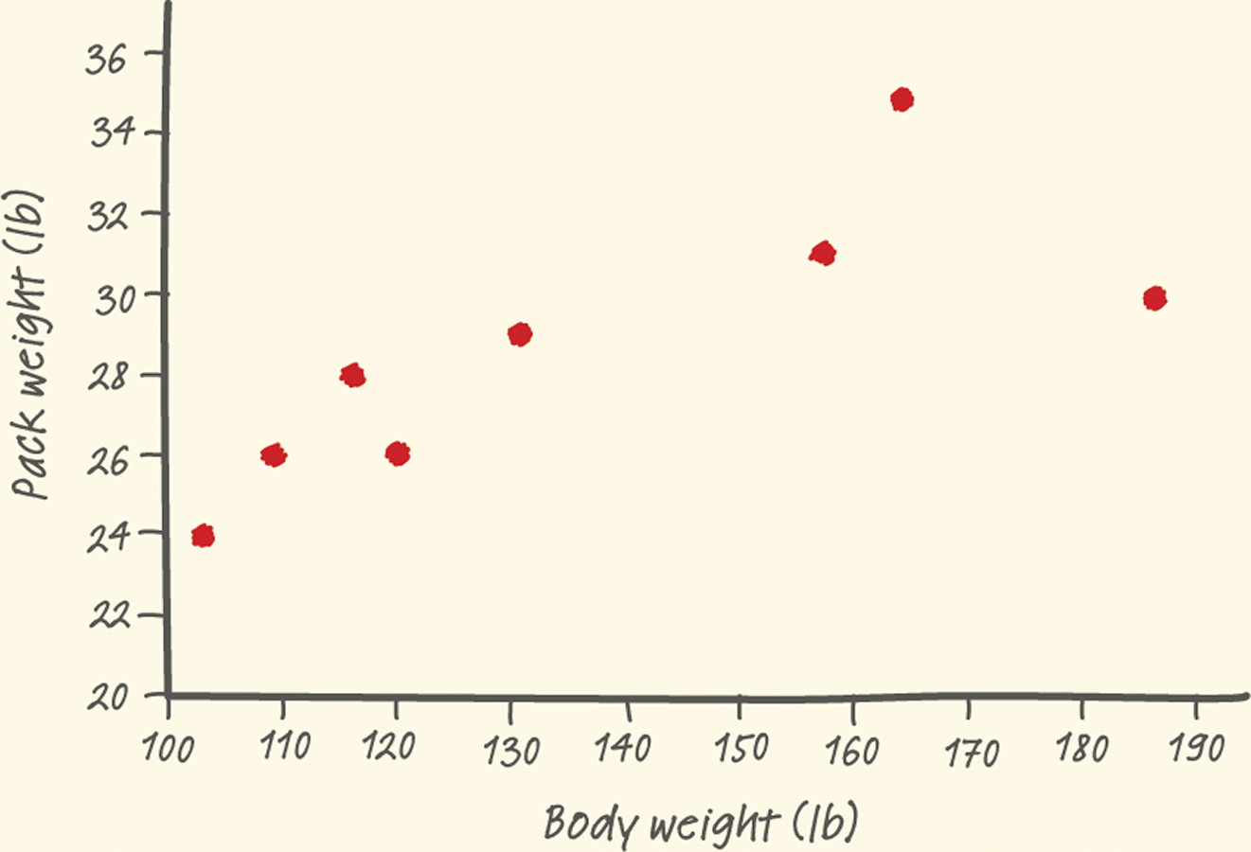

Interpreting Scatterplots
Two variables have a positive association when above-average values of one tend to accompany above-average values of the other, and when below-average values also tend to occur together.
Two variables have a negative association when above-average values of one tend to accompany below-average values of the other.
There is one possible outlier, the hiker with the body weight of 187 pounds seems to be carrying relatively less weight than are the other group members.
Strength
Direction
Form
There is a moderately strong, positive, linear relationship between body weight and pack weight.
It appears that lighter hikers are carrying lighter backpacks.

Slide 8
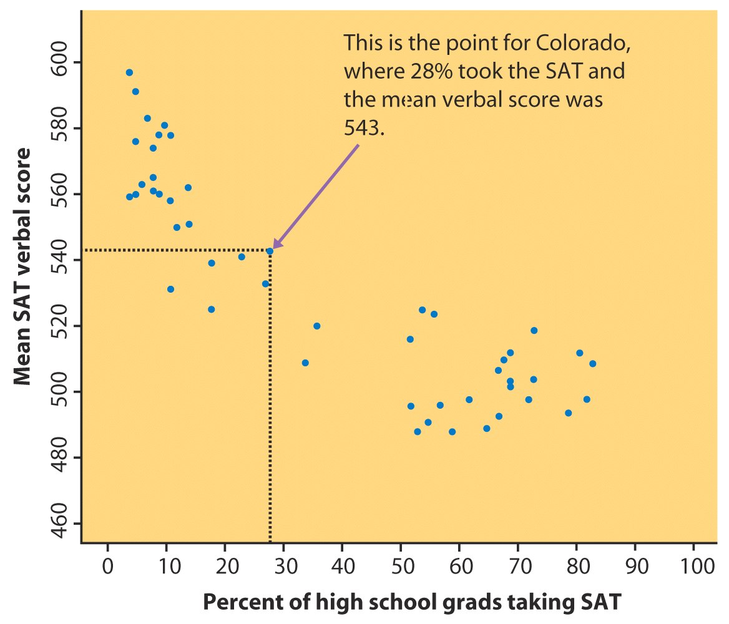
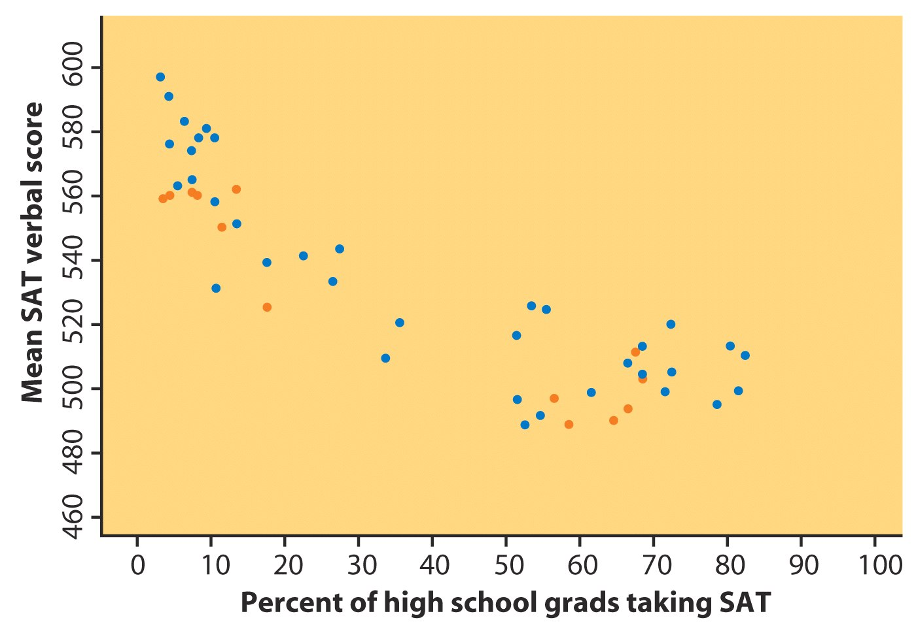
Adding Categorical Variables
Consider the relationship between mean SAT verbal score and percent of high-school grads taking SAT for each state.
Southern states highlighted
To add a categorical variable, use a different plot color or symbol for each category.

Slide 9
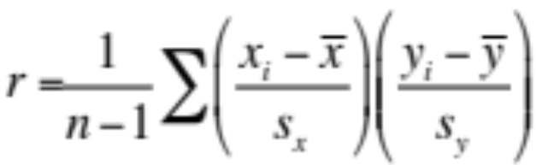
Measuring Linear Association
A scatterplot displays the strength, direction, and form of the relationship between two quantitative variables.
The correlation r measures the strength of the linear relationship between two quantitative variables.
  r is always a number between -1 and 1.
  r > 0 indicates a positive association.
  r < 0 indicates a negative association.
  Values of r near 0 indicate a very weak linear relationship.
  The strength of the linear relationship increases as r moves away from 0 toward -1 or 1.
  The extreme values r = -1 and r = 1 occur only in the case of a perfect linear relationship.

Slide 10
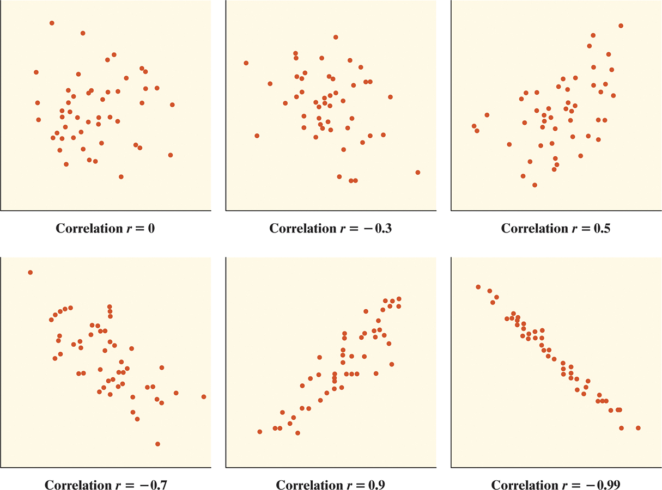
Correlation

Slide 11
Facts About Correlation
Correlation makes no distinction between explanatory and response variables.
r has no units and does not change when we change the units of measurement of x, y, or both.
Positive r indicates positive association between the variables, and negative r indicates negative association.
The correlation r is always a number between -1 and 1.
Cautions:
Correlation requires that both variables be quantitative.
Correlation does not describe curved relationships between variables, no matter how strong the relationship is.
Correlation is not resistant. r is strongly affected by a few outlying observations.
Correlation is not a complete summary of two-variable data.

Slide 12
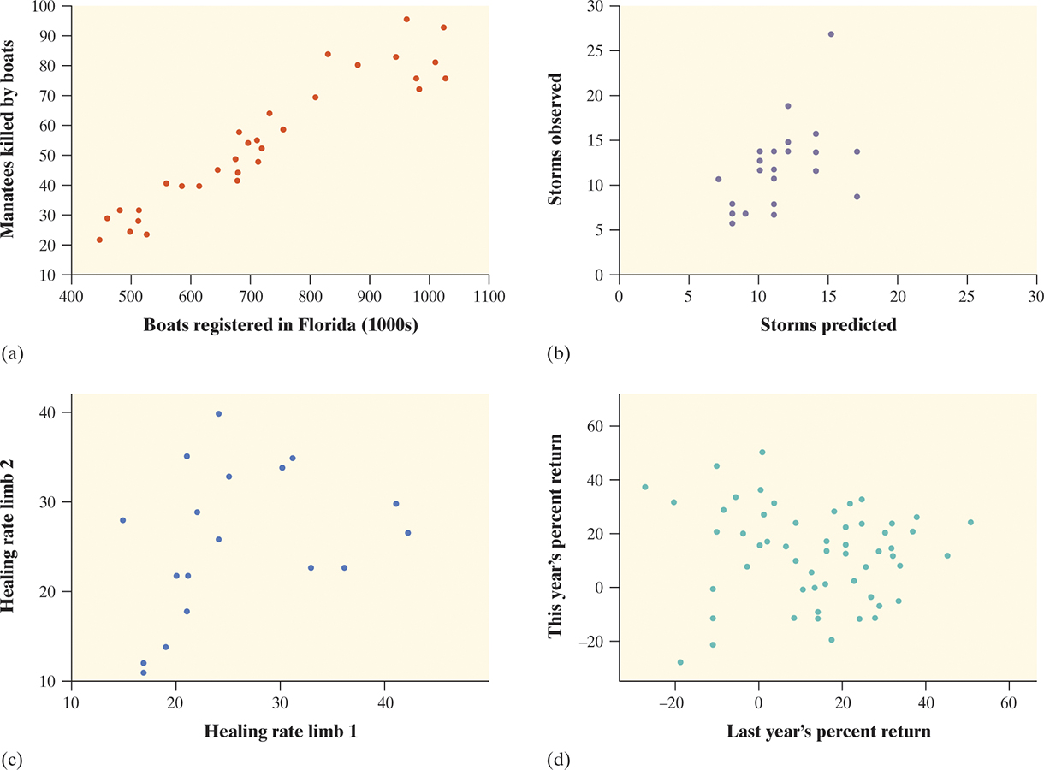
Correlation Practice
  For each graph, estimate the correlation r and interpret it in context.

Slide 13
Chapter 4 Objectives Review
Define explanatory and response variables
Construct and interpret scatterplots
Add categorical variables to scatterplots
Calculate and interpret correlation
Describe facts about correlation

